Slide 1
Cancescu Mihai
Boolean function, Moisil simplification 8.8

Slide 2
Problem Statement
f(x1,x2,x3)=m0vm3vm4vm6vm7

Slide 3
Simplifying a Boolean function (given in disjunctive canonical form) means covering all its minterms with a minimum number of maximal monoms and a minimum number of overlaps
Simplification process steps ( steps 2, 3 are specific to Moisil’s method, which is an algebraic simplification method) :
The initial function f is transformed into DCF(f).
The set of maximal monoms are calculated using either one of Veitch-Karnaugh diagrams ( a graphical method) or Quine’s method ( an analytical method). For simplifying f₈ we will use Quine’s method.
In order to obtain the simplified forms of the function from the set of maximal monoms, we will use propositional logic.

Slide 4

Since our initial function (f₈ (x₁, x₂, x₃) = m₀ v m₃ v m₄ v m₆ v m₇ = $\overline{x_{1}}$ $\overline{x_{2}}$ $\overline{x_{3}}$ v $x_{1}\overline{x_{2}}$ $\overline{x_{3}}$ v $x_{1}\overline{x_{2}}$ $\overline{x_{3}}$v $x_{1}x_{2}\overline{x_{3}}$ v $x_{1}x_{2}x_{3}$) is already given in DCF, we will jump straight to the factorization process. We will use Quine’s method in order to find the set of maximal monoms M(f).
S_{f} = {(0, 0, 0), (0, 1, 1), (1, 0, 0), (1, 1, 0), (1, 1, 1)} – the support set of f
The first step of Quine’s method is to order the support set of f with respect to the number of “1” values in each 3-tuple.
S_{f} = {(0, 0, 0), (1, 0, 0), (1, 1, 0), (0, 1, 1), (1, 1, 1)} (ascending order)
The minterms from the function’s expression are represented using the powers of variables, in a tableau, each minterm on a line, in ascending/ descending order, with respect to the number of “1” values in the 3-tuples of the support of the function. The header of the tableau contains the variables’ names.
Clic pentru a adăuga text

Slide 5
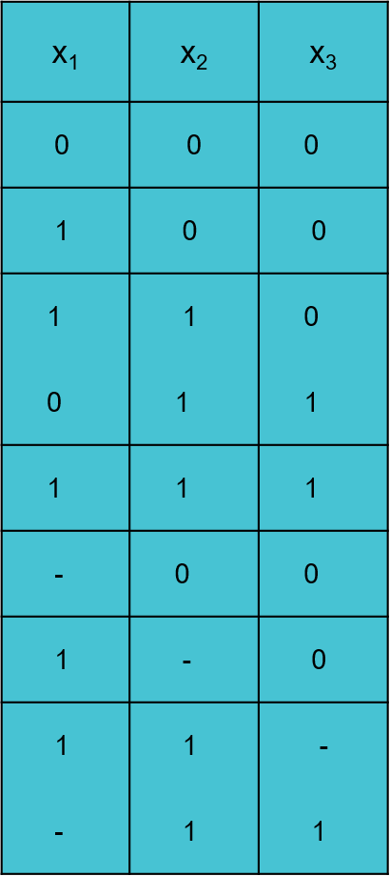
S_{f} = {(0, 0, 0), (1, 0, 0), (1, 1, 0), (0, 1, 1), (1, 1, 1)}
I m0
Ii m4
Iii m6
m3
Iv m7
v=i+ii m0vm4= x2x3=max1
vi=ii+iii m4vm6=x1x2=max2
Vii=iii+iv m6vm7=x1x2=max3
m3vm7=x2x3=max4

Slide 6

The set of maximal monoms obtained:
M(f) = {$\overline{x_{2}}$ $\overline{x_{3}}$, $x_{1}\overline{x_{3}}$, $x_{1}x_{2}$, $x_{2}x_{3}$} = {max1, max2, max3, max4}

Slide 7
All the minterms from the function’s expression must be covered by a minimum number of maximal monoms, with a minimum number of overlaps. This statement is modelled by the following propositional formula obtained as a conjuction of al previous true sentences:
p₁ ˄ (p₁ v p₂) ˄ (p₂ v p₃) ˄ p₄ ˄ (p₃ v p₄) ≡ T (CNF with 5 clauses)
This CNF is then transformed into a DNF.
Apply DISTRIBUTIVE laws:
T ≡ (p₁ ˄ p₁ ˄ p₂ ˄ p₄) v (p₁ ˄ p₂ ˄ p₂ ˄ p₄) v (p₁ ˄ p₁ ˄ p₃ ˄ p₄) v (p₁ ˄ p₂ ˄ p₃ ˄ p₄)
Apply IDEMPOTENCY:
T ≡ (p₁ ˄ p₂ ˄ p₄) v (p₁ ˄ p₂ ˄ p₄) v (p₁ ˄ p₃ ˄ p₄) v (p₁ ˄ p₂ ˄ p₃ ˄ p₄)
Apply ABSORTION:
T ≡ (p₁ ˄ p₂ ˄ p₄) v (p₁ ˄ p₃ ˄ p₄) (DNF with 2 cubes is obtained

Slide 8

T ≡ (p₁ ˄ p₂ ˄ p₄) v (p₁ ˄ p₃ ˄ p₄) (DNF with 2 cubes)
A DNF (disjunction of cubes) is true is at least one of its cubes is true.
For the cube (p₁ ˄ p₂ ˄ p₄) ≡ T:
$f_{1}^{s}$(x₁, x₂, x₃) = max₁ v max₂ v max₄ = $\overline{x_{2}}$ $\overline{x_{3}}$ v $x_{1}\overline{x_{3}}$ v $x_{2}x_{3}$
For the cube (p₁ ˄ p₃ ˄ p₄) ≡ T :
$f_{2}^{s}$(x₁, x₂, x₃) = max₁ v max₃ v max₄ = $\overline{x_{2}}$ $\overline{x_{3}}$ v $x_{1}x_{2}$ v $x_{2}x_{3}$

Slide 9
Thanks for your attention! :)

